Slide 1
ICS: The Incident Command System
Roy Newton
Lombard Police Department
Chief of Police
DuPage County Incident management team

Slide 2
Current Trends
What is your Chain of Command
Have you practiced
What is a Lockdown
Soft – No imminent danger
Hard – Implies imminent danger is known, take action
Do you have a program in place (ALICE Alert Lockdown Inform Counter Evacuate) or Run Hide Fight
Questions Now?

Slide 3
What is Incident Command
Standardized, on-scene, ALL-hazard incident management concept
Allows users to adopt an integrated organizational structure to match the complexities and demands of a single or multiple incidents without being hindered by jurisdictional boundaries
Structure:
Incident Commander
Safety Officer
Logistics Officer
Planning Officer
Information Officer

Slide 4
Purpose
Using management best practices to ensure:
The safety of responders and others
The achievement of tactical objectives
The efficient use of resources

Slide 5
Benefits
Meets the needs of incidents of any kind or size
Allows personnel from a variety of agencies to meld rapidly into a common management structure
Provides logistical and administrative support to operational staff
Is COST EFFECTIVE by avoiding duplication of efforts

Slide 6
Basic Features of ICS
Common Terminology – Language
Modular Organization
Management by Objectives
Reliance on an Incident Action Plan (IAP)
Chain of Command and unity of command
Unified Command
Manageable Span of Control

Slide 7
Additional Features
Designated incident locations and facilities
Resource management
Information and Intelligence management
Integrated communications
Transfer of Command
Accountability

Slide 8
Common Terminology
Using common terminology to define
Organizational functions
Incident facilities
Resource descriptions
Position titles
Communications should be in plain English or clear text
Cannot use radio codes, agency specific codes, or police / fire jargon
What if a police situation and only officers there, can’t we use our jargon?

Slide 9
Huh?
This is Lincoln 1, we have a 10-37 that requires a code 2 response
How about:
This is Unit Lincoln 1, the flood waters are rising and we need additional resources for sandbagging

Slide 10
ICS Model
Top-Down modular fashion
Based on the size and complexity of incident
Based on the hazard environment created by the incident
Objectives determine organizational size
Fill functions and positions that are necessary
Each area must have a person in charge

Slide 11
Objectives
ICS is managed by objectives
Objectives are communicated throughout the entire ICS organization through the incident planning process
Objective Priority:
Life Saving
Incident Stabilization
Property Preservation

Slide 12
How Do We Meet That
Reliance on an Incident Action Plan (IAP)
Every Incident must have an IAP
Specifies the objectives
Activities to be completed
Covers a specific time period (operational period)
May be oral but not best practice – best to have written plan

Slide 13
Elements of a IAP
What do we want to do?
Who is responsible for doing it?
How do we communicate?
What is the procedure if someone is injured?
Who talks to Who?
Who is in charge?

Slide 14
Chain of Command
An orderly line of authority within the ranks of the incident management organization
Unity of Command
Report to only ONE supervisor, and
Receive work assignments only from their supervisor, thus
No individual should answer to more than ONE supervisor
UNIFIED COMMAND: Enables all agencies to manage an incident together by establishing a common set of objectives and strategies
Allows for joint decisions

Slide 15
Manageable Span of Control
Too many Cooks in the Kitchen
Pertains to the number of individuals or resources that one supervisor can manage effectively during an incident
Span is between 3 to 7 subordinates but optimally does not exceed 5

Slide 16
Incident Facilities
Incident Command Post – GREEN LIGHT
All incidents will have a Command Post
Staging Areas of personnel and equipment
What is around you to use
Hotel
Parking lots
Malls
Schools
Parks

Slide 17
Incident Command
WHADDA YA GOT
WHADDA YA DONE
WHADDA YA NEED
Commander assumes command
Assigns / Creates staff
Delegates
Provides Leadership
Ensures incident safety

Slide 18
Other Staff as Necessary
Safety Officer – Authority to STOP an operation
Liaison Officer
Public Information Officer
Operations – Develops and implements plans and strategies, also tactical response and staging
Logistics – Water, Food, Bathroom, Equipment
Planning – Gathers intelligence, compiles action plan
Finance

Slide 19
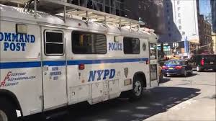
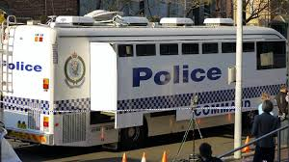
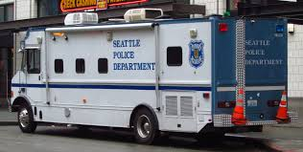
Command Posts

Slide 20
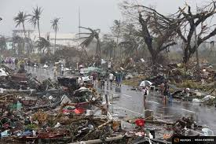
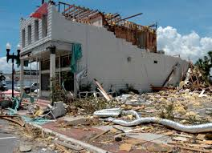
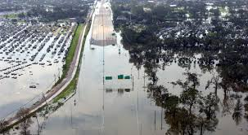
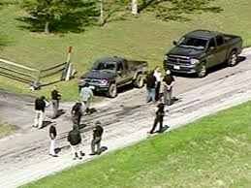
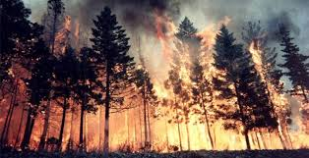
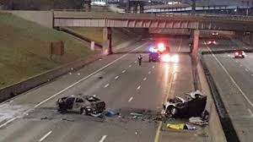
Incidents for Police / Fire

Slide 21
School Plans
Your schools are entrusted to provide safe and healthy learning environment
Your parents expect it!
Human caused emergencies (crime and violence)
Natural Disasters
Disease Outbreaks
Accidents

Slide 22
Planning
Planning must be supported by leadership
Planning uses assessment to customize plans to your building. The unique outline. Layout, and resources to your building
Planning considers ALL threats and Hazards
Planning for the entire school population (disabilities)
Planning for ALL times and field trips

Slide 23
Process
Develop an EOP – Emergency Operations Plan with your community partners (police and fire)
Identify Hazards
Goals - Indicate a desired outcome
Before – Prevent a Fire
During – Protect persons from injury
After – Provide Medical Attention
Objectives – Specific, Measurable actions to achieve goals such as provide training and proper storage of equipment

Slide 24
Operations
Who has the authority to activate the plan
Who is contacted based on the plan
Police
Fire
Parents
Health Department
Other Schools in District
Actions taken before, during, after
Prevent, Protect, Mitigate
Respond and minimize impact on life and property
Recover after emergency

Slide 25
ICS Organization -School
Determine the roles and responsibilities
Administrators
Principal
Teachers
Instructional Aides
Counselors
Social Workers
Nurse
Maintenance Staff
SRO
Parents

Slide 26
Example
Maintenance
Administrator
Principal
Social Workers
Teachers
Direct students to inside / outside assembly areas
Account for students
Report missing
Obtain and direct to first aid

Slide 27
Training and Exercises
To support the plan, critical training and excerises should be practiced.
Training ensures that staff, students, faculty, and parents understand roles, responsibilities, and expectations.
What is the frequency of exercises?
Does your district or municipality mandate training
Basic Fire, Shelter in Place, Tornado

Slide 28
Training
Evacuation – How to safely move students
To designated areas
When the route is unusable
When students are not with a teacher or staff member
Students with disabilities
Lockdown – Threat in / around school
How to lock doors OR when not safe to do so
How does a particular classroom impact a lockdown
Variations of a lockdown – Hard / Soft
Soft visitors are closely monitored but all activities remain normal

Slide 29
Training
Shelter in Place – Safer inside than outside for an extended period of time
Do rooms need to be sealed from chemical or biological threat or issue
Weather shelter considerations
Supplies needed
Need to move again or integration of safe rooms

Slide 30
Training
Accounting for All Persons
How to determine who is in attendance at the assembly
What to do when a student, staff, guest, is not located
Who reports to assembly supervisor
Who / How determines and announces when students will be dismissed or released
Communications / Warning
Radio and School broadcast system
Can staff operate
Contact authorities
Media

Slide 31
Those Parents
Family Reunification
How to inform families in advance and describe their roles
Who is authorized to take custody of a student
Parent check-in / check out procedures
Students who leave on their own
Technology rules
Language barriers
Do you have a system

Slide 32
Maintenance of Plan
After a real event or exercise
Did the plan work
What can be changed or modified
Who needs to be “re-assigned”
Did that exit work?
Was that area safe?

Slide 33
Back to ICS – UGH!
Support for all types of emergencies
Management of resources
Policies and Procedures that exist outside the plan
Identify administrative controls – budget and expenditures
Maintain accurate logs of actions – activities
How are vital records preserved
Policy for keeping financial records, tracking resources needs or use, acquiring resources, and future compensation

Slide 34
Recovery
Academic Recovery (back to school)
Physical Recovery (assets, utility, insurance)
Fiscal Recovery (gov’t relief, payroll, insurance)
Psychological and Emotional Recovery
Team leader
Counseling
Psychological First Aide
Short – Long term
Commemorations, memorial activity, markers, statues
Readiness and Emergency Management for Schools
Rems.ed.gov

