Slide 1
Technology in the Digital Classrooms, Where Teachers Prepare for the Future
Dr. Seema A. Imam
National Louis University
Islamic Society of North America
March 25-27, 2016 Rosemont, IL
Notes:
This template can be used as a starter file for presenting training materials in a group setting.
Sections
Sections can help to organize your slides or facilitate collaboration between multiple authors. On the Home tab under Slides, click Section, and then click Add Section.
Notes
Use the Notes pane for delivery notes or to provide additional details for the audience. You can see these notes in Presenter View during your presentation.
Keep in mind the font size (important for accessibility, visibility, videotaping, and online production)
Coordinated colors
Pay particular attention to the graphs, charts, and text boxes.
Consider that attendees will print in black and white or grayscale. Run a test print to make sure your colors work when printed in pure black and white and grayscale.
Graphics, tables, and graphs
Keep it simple: If possible, use consistent, non-distracting styles and colors.
Label all graphs and tables.

Slide 2
This presentation is designed to discuss and demonstrate new skill sets for teachers in their personal professional development as well as for their own classroom delivery. As schools send students in to a world filled with digital interactivity, they must experience the new digital library, the digital assignment, assessment and 3-D technologies as well as the Maker Spaces. Creating digital classrooms for interacting with the global world is today’s technology challenge.
Notes:
Use a section header for each of the topics, so there is a clear transition to the audience.

Slide 3
Muslim community and our students strive to excel in education
Need to be leaders----in education including in technology locally and worldwide
Principals –lead
Teachers—lead
Parents –lead
Students ---lead
Notes:
Give a brief overview of the presentation. Describe the major focus of the presentation and why it is important.
Introduce each of the major topics.
To provide a road map for the audience, you can repeat this Overview slide throughout the presentation, highlighting the particular topic you will discuss next.

Slide 4
http://www.nowhereroad.com/twt/animations/TechAdopt.html

Slide 5
Reading the free journal –stay current

Slide 6
Reading the free journal –stay current

Slide 7
Professional Development
Listserves:
1. edutopia, http://www.edutopia.org/
2. Eschool http://www.eschoolnews.com/
Conferences :
1. ISTE –International Society for Technology Education http://www.iste.org/standards
2. In IL attend the ICE conference Illinois Computer Educators—held in February in St.Charles,IL on a Fri/Sat
http://www.iceberg.org/ice_conference

Slide 8
Resources
Curtis Bonk (free book Tec-Variety)
http://tec-variety.com/
The Journal (Free Journal –read electronically or on paper from snail mail)
https://thejournal.com/
Tech and Learning (Free Journal –read electronically or on paper from snail mail)
www.techlearning.com/

Slide 9
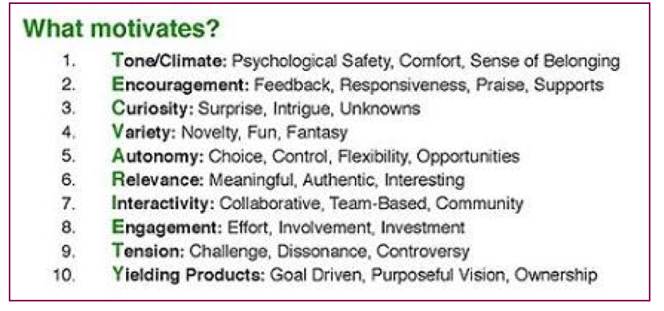
Get the free book:
Free E-book PDF, Chapters Kindle Version

Slide 10
Curtis Bonk’s Book Tec-Variety
In this book, you will discover: A wellspring of Web resources;
10 fully documented successful motivational principles;
Hundreds of activities to motivate and engage online learners;
Proven ideas on how to design interactive and collaborative courses;
A realistic path toward meaningful and relevant online learning;
Detailed risk, cost, and time guidelines for each activity;
A thoroughly researched basis for each idea and activity;
Hope (yes, real hope!) for engaging online learners.

Slide 11
Creators
& Curators
Classroom Delivery !!
Notes:
This is another option for an overview using transitions to advance through several slides.

Slide 12
ISTE Standards
For our leaders, teachers and students !

Slide 13
ISTE Standards
For our leaders, teachers and students !

Slide 14
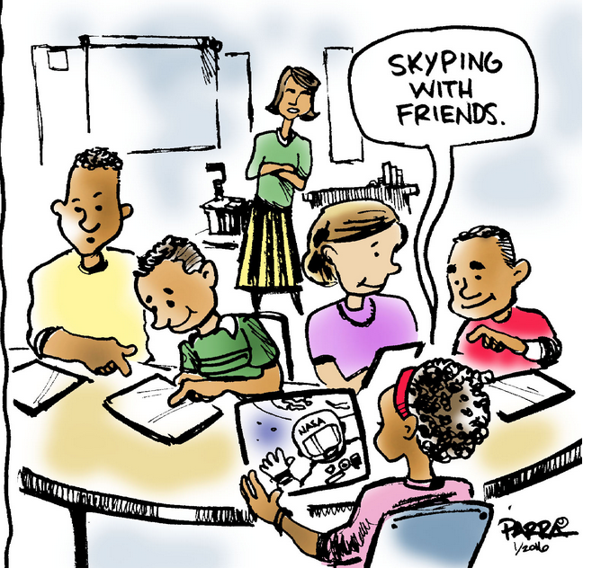
Connect your students with Science
http://www.iste.org/standards/ISTE-standards/standards-for-students
https://www.iste.org/explore/articleDetail?articleid=670&category=In-the-classroom&article=
NASA’s Digital Learning Network. Engaging with scientists from the U.S. National Aeronautics and Space Administration (NASA) is now at your fingertips through these free and interactive webcasts and videoconferences that allow students of all ages to work hand in hand with NASA’s experts and educational specialists. Educators can find a list of upcoming events related to astronomy, physics, algebra and more on the website. Each event provides teachers with downloadable educator guides and tips on what students need to have on the day of the event.

Slide 15
The JASON Project. If your classroom adventures lead you into a world of nature exploration, then this project may be the right fit. You and your students can engage with hurricane or tornado researchers live from the U.S. National Oceanic and Atmospheric Administration (NOAA). Working side by side with leading experts from NASA, NOAA, the U.S. Department of Energy, and the National Geographic Society, educators can use the JASON curriculum to teach about weather, ecology and energy.
Connect your students with Science

Slide 16
New Directions
What are the ISTE NETS:
Student technology standards

Slide 18
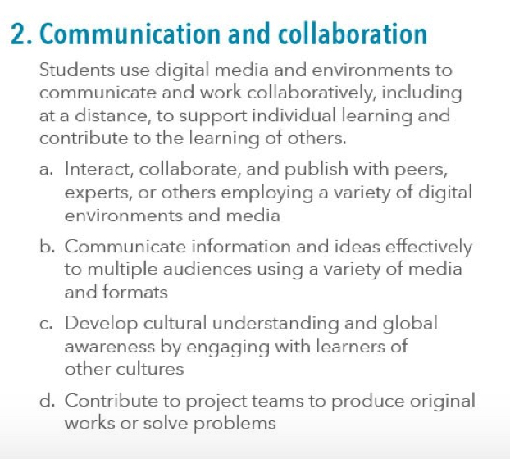

Slide 19
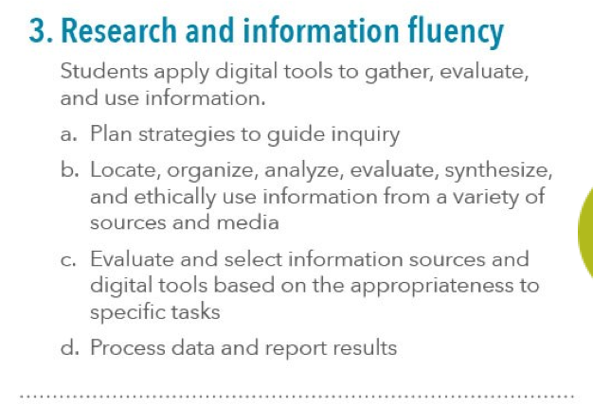

Slide 21
MAKER SPACES:
A Great Blog READ all
About A library make over !
Makerspaces, sometimes also referred to as hackerspaces, hackspaces, and fablabs are creative, DIY spaces where people can gather to create, invent, and learn. In libraries they often have 3D printers, software, electronics, craft and hardware supplies and tools, and more.
A Librarian's Guide to Makerspaces: 16 Resources |OPEN EDUCATION DATA BASES
OEDB.org
http://oedb.org/ilibrarian/a-librarians-guide-to-makerspaces/

Slide 22
New Work
The technology learning curve Maybe how we prepare for safety
Notes:
Add slides to each topic section as necessary, including slides with tables, graphs, and images.
See next section for sample table, graph, image, and video layouts.

Slide 23
Before we use the website
Completely vet the site before using – Along with these preceding ideas, take a moment to examine the site itself. Just like previewing a video, be sure that the site is school and grade level appropriate. The school district may even have a vetting form or process. Ask if one exists… or should exist. In the next post you will find a possible vetting form to consider.
Notes:
What will the audience be able to do after this training is complete? Briefly describe each objective and how the audience will benefit from this presentation.

Slide 24
Today’s Overview
1
2
Getting Standards to guide us
3
Growing a lot in order to meet the challenges
Teacher Professional Development
Notes:
This is another option for an overview slide.

Slide 25
Questions?
Dr. Seema Imam
seemaimam@gmail.com
312-835-2758

